Slide 1
Soccer Analytics via Visual Deep Learning
Mohieddine Amine
Tarek Dghaily
Thursday July 13th 2017

Slide 2
Outline
A Branch of Sports Analytics
Purposes
Available Datasets
Network Types
Metrics

Slide 3
Outline
A Branch of Sports Analytics
Purposes
Available Datasets
Network Types
Metrics

Slide 4


Soccer Analytics as a Branch of Sports Analytics
Increased focus on activity and event detection in sport videos
More focus on classification of sport type rather than events
Why soccer? Because soccer is popular and rich of contextual information

Slide 5

Objectives and Challenges:
Need for:
Organization
Classification
Example: Improvement in recommender systems, search engines, etc.
Tremendous increase in visual data

Slide 6

Objectives and Challenges:
Choice of Architecture
Choice of Dataset
Computational Efficiency
State-of-the-art techniques

Slide 7
Outline
A Branch of Sports Analytics
Purposes
Available Datasets
Network Types
Metrics

Slide 8
Soccer Analytics for Game Summarization or Tactical Analysis
Two main purposes for soccer analytics:
Game summarization
Tactical analysis

Slide 9
Game Summarization
Event Detection
Event Classification
Event Highlighting
Major Events of interest:
Goal
Substitution
Foul (Yellow or Red Card)
Penalty
Off-side
Corner
Free kick

Slide 10

Tactical Analysis
Focus on player behavior
Focus on team as a collective
Predictive rather than descriptive

Slide 11
Outline
A Branch of Sports Analytics
Purposes
Available Datasets
Network Types
Metrics

Slide 12



Datasets
Two differentiable types of datasets:
Annotated soccer videos based on the major events
Match reports focusing on behavioral activities and interactions
Goal
Yellow Card

Slide 13
Datasets
Annotated Videos:
Event detection/classification
Temporal information
Reliance on visual (audio?) data
Substitution
Goal
Yellow Card

Slide 14
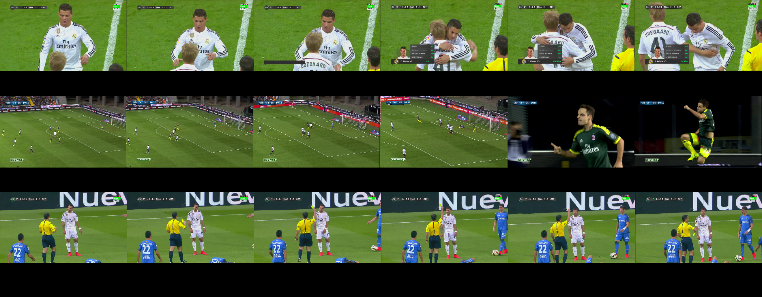


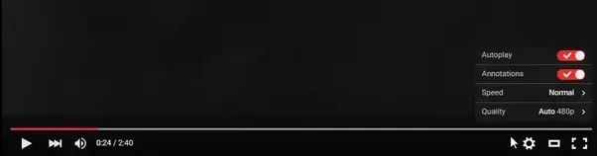
Datasets
Annotated Videos:

Slide 15

Datasets
Match Reports:
Tactical Analysis
Tracking players
Reliance on both visual and statistical data
Mainly used for behavioral and strategical predictions

Slide 16
Common Datasets
ActivityNet 200
Human Motion DataBase (HMDB51)
UCF101
THUMOS’15
Sports 1M
Soccer Semantic Image Dataset (SSID)

Slide 17

ActivityNet 200 (Heilbron et. al)
203 classes including personal care, household activities, sports, etc.
137 untrimmed videos per class
1.54 activity instances per video
Broad range of human activities
Not exclusive to sports
Link: http://www.cv-foundation.org/openaccess/content_cvpr_2015/papers/Heilbron_ActivityNet_A_Large-Scale_2015_CVPR_paper.pdf

Slide 18
Common Datasets
ActivityNet 200
Human Motion DataBase (HMDB51)
UCF101
THUMOS’15
Sports 1M
Soccer Semantic Image Dataset (SSID)

Slide 19
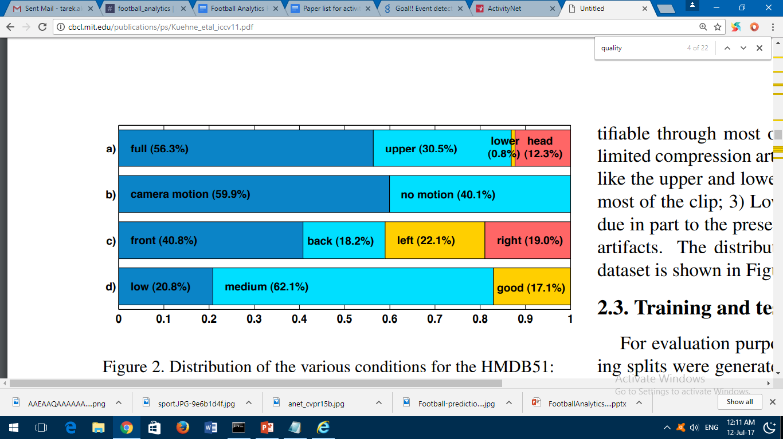
Human Motion DataBase - HMDB (Kuehne et. al)
7000 manually annotated clips ranging from digitized movies to YouTube
51 classes
Link: http://serre-lab.clps.brown.edu/wp-content/uploads/2012/08/Kuehne_etal_ICCV2011.pdf
(a): Body Part
(b): Camera Motion
(c): Camera Viewpoint
(d): Clip Quality

Slide 20
Common Datasets
ActivityNet 200
Human Motion DataBase (HMDB51)
UCF101
THUMOS’15
Sports 1M
Soccer Semantic Image Dataset (SSID)

Slide 21

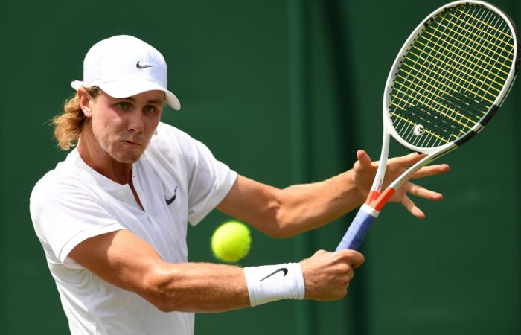
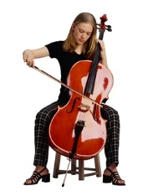
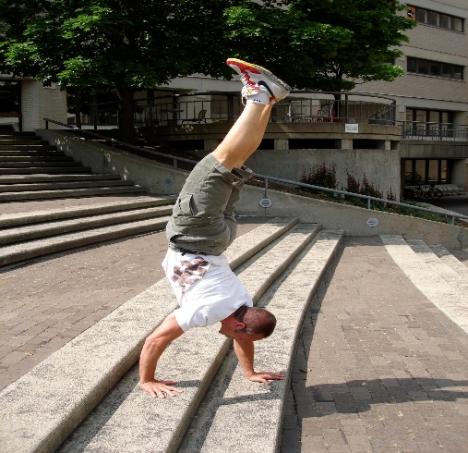
UCF101 (Soomro et. al)
Five main categories of action:
Human-object interaction
Body-motion
Human-human interaction
Playing musical instruments
Sports
Link : http://crcv.ucf.edu/data/UCF101.php

Slide 22
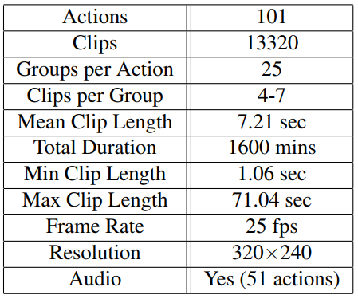
UCF101 (Soomro et. al)
101 action classes
Over 13k clips
Unconstrained nature
Dynamic background
Camera motion

Slide 23
Common Datasets
ActivityNet 200
Human Motion DataBase (HMDB51)
UCF101
THUMOS’15
Sports 1M
Soccer Semantic Image Dataset (SSID)

Slide 24
Thumos’15
Training Set: over 13,000 trimmed videos from 101 action classes.
Validation Set: Over 2100 untrimmed videos with annotations of actions.
Background Set: 3000 relevant videos not to include any instance of the 101 actions.
Test Set: Over 5600 untrimmed videos with ground truth.
Link: http://www.thumos.info/home.html

Slide 25
Common Datasets
ActivityNet 200
Human Motion DataBase (HMDB51)
UCF101
THUMOS’15
Sports 1M
Soccer Semantic Image Dataset (SSID)

Slide 26
Sports 1M (Karpathy et. al)
More than one million sports videos
487 sports classes
1000-3000 videos per class
5% annotated with more than one class
Link to the paper: http://cs.stanford.edu/people/karpathy/deepvideo/index.html

Slide 27
Common Datasets
ActivityNet 200
Human Motion DataBase (HMDB51)
UCF101
THUMOS’15
Sports 1M
Soccer Semantic Image Dataset (SSID)

Slide 28
Soccer Semantic Image Dataset (Jiang et. Al)
Nine different classes of images based on sematic view
Specific for soccer
Consists of 30 match videos
Link to the paper: http://ieeexplore.ieee.org/abstract/document/7814641/

Slide 29
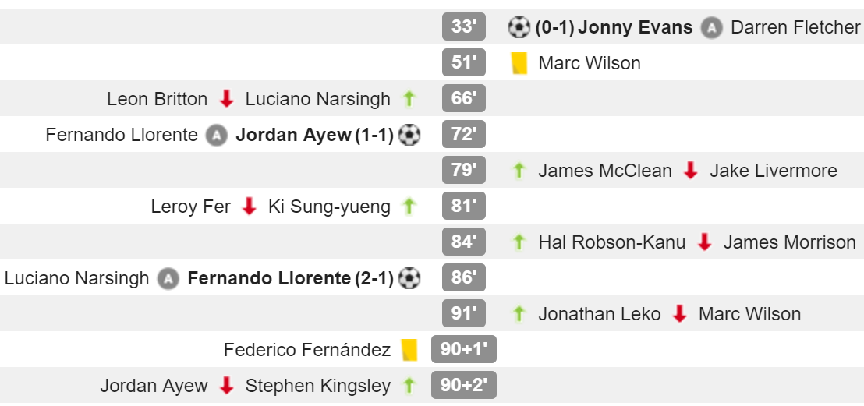
Soccer Semantic Image Dataset (Jiang et. Al)
Larger Training Dataset
30 matches can be deficient
Skew dataset
(whoscored.com)

Slide 30
Summary
Criteria | ActivityNet | HMDB51 | UCF101 | THUMOS’15 | Sports 1M | SSID
Number of Classes | 203 | 51 | 101 | 101 | 487 | 9
Year | 2015 | 2011 | 2012 | 2015 | 2014 | 2016
Number of Videos | 27k | 7k | 13k | 23k | > 1M | 30
Length (Video Hours) | 648 | 1300 | 26 | 430 | NA | 45
Focus on Soccer | ☒ | ☒ | ☒ | ☒ | ☒ | ☑
Availability | ☑ | ☑ | ☑ | ☑ | ☑ | ☒

Slide 31
Verdict
Need for a soccer specific dataset
Need for a sufficient number of training and testing videos
Focus on events in soccer videos
Need for our Own Custom Dataset

Slide 32
Our Dataset
Consists of 171 soccer games from different leagues and championships
Events annotated up to a second accuracy
Events include but not limited to goal, substitutions and red/yellow cards
All the videos are HD (720p or 1080p)

Slide 33
Summary
Criteria | ActivityNet | HMDB51 | UCF101 | THUMOS’15 | Sports 1M | SSID | Our Dataset
Number of Classes | 203 | 51 | 101 | 101 | 487 | (Slide 29) | 5
Year | 2015 | 2011 | 2012 | 2015 | 2014 | 2016 | 2017
Number of Videos | 27k | 7k | 13k | 23k | > 1M | 30 | 342
Length (Video Hours) | 648 | 1300 | 26 | 430 | NA | 45 | 256
Focus on Soccer | ☒ | ☒ | ☒ | ☒ | ☒ | ☑ | ☑
Availability | ☑ | ☑ | ☑ | ☑ | ☑ | ☒ | ☑

Slide 34
Outline
A Branch of Sports Analytics
Game Summarization Vs Tactical Analysis
Dataset Nature in System Construction
Network Types
Scoring and Evaluation Metrics

Slide 35
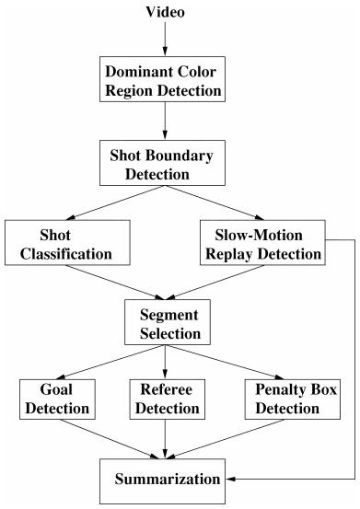
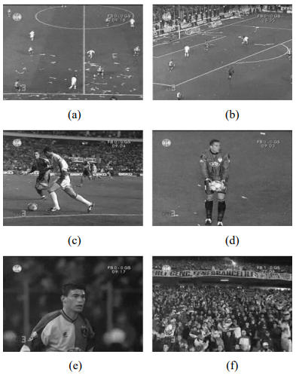
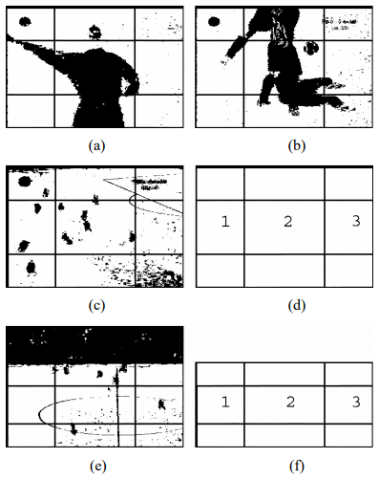
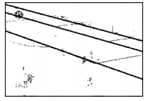
Network Types – Related Work
Ekin et al. : A cornerstone work in Soccer Analytics
Shots must be classified!
Frame Segmentation
Mid Shot
Penalty Shot
Player Shot
Crowd Shot
(Ekin et al. , 2003)
Line Detection
Ekin, Ahmet, A. Murat Tekalp, and Rajiv Mehrotra. "Automatic soccer video analysis and summarization." IEEE Transactions on Image processing 12.7 (2003): 796-807.

Slide 36
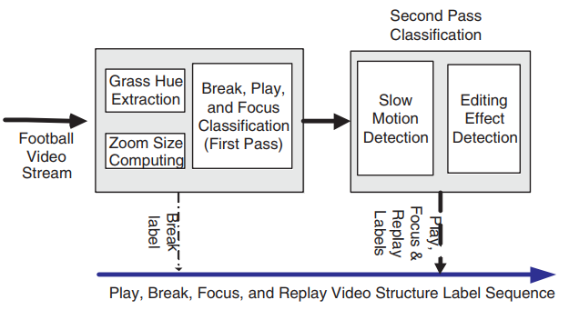
Network Types – Related Work
Several focuses between architectures:
Deeper context
(Ren et al. , 2005)
Ren, Reede, and Joemon M. Jose. "Football video segmentation based on video production strategy." European Conference on Information Retrieval. Springer, Berlin, Heidelberg (2005).

Slide 37
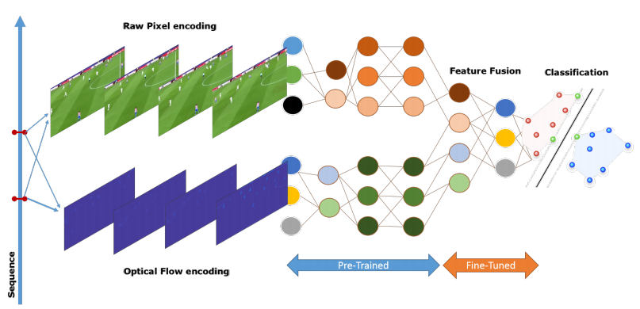
Network Types – Related Work
Several focuses between architectures:
Spatio-temporal analysis:
Tsagkatakis, Grigorios, Mustafa Jaber, and Panagiotis Tsakalides. "Goal!! Event detection in sports video." Electronic Imaging 2017.16 (2017): 15-20.

Slide 38
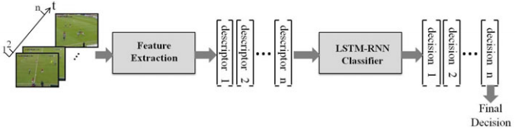
Network Types – Current Work
Spatio-temporal analysis: Baccouche et al.
SIFT and BoW Approach
LSTM-RNN Classifier
(Baccouche et al. , 2010)
Baccouche M., Mamalet F., Wolf C., Garcia C., Baskurt A. (2010) Action Classification in Soccer Videos with Long Short-Term Memory Recurrent Neural Networks.

Slide 39
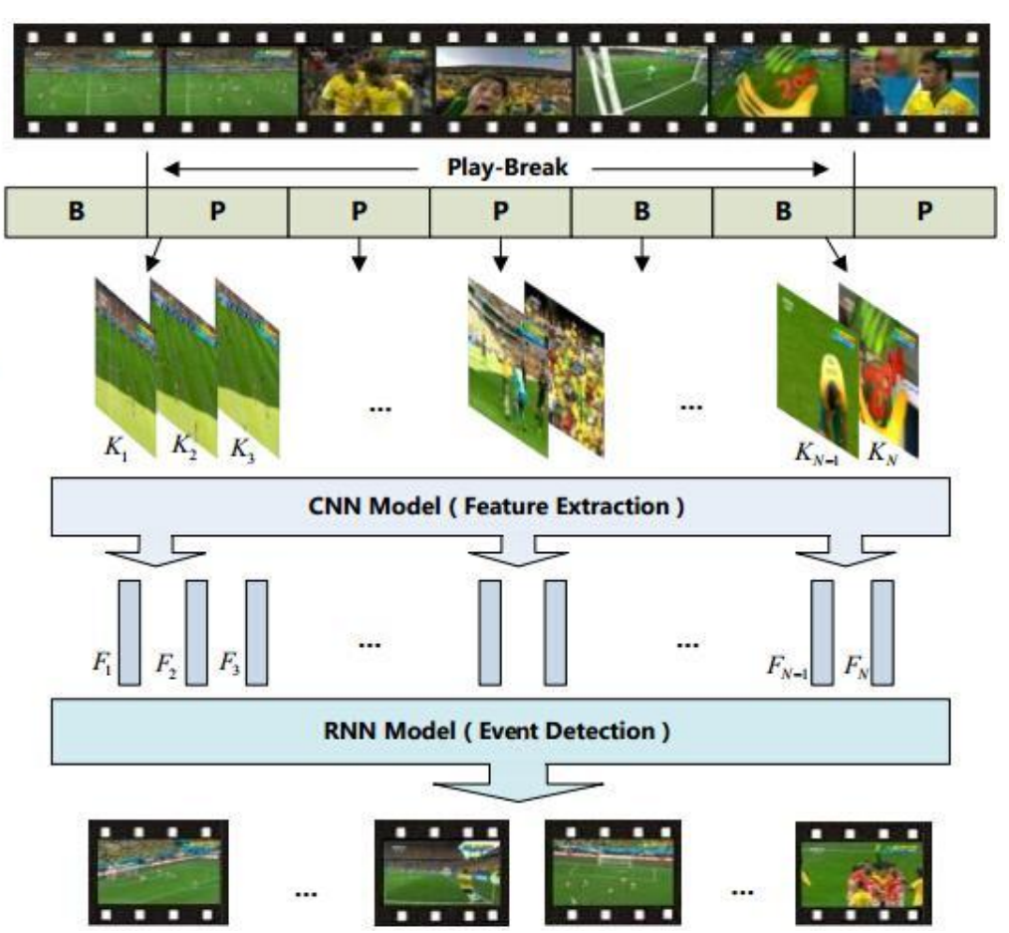
Network Types – Current Work
Spatio-temporal analysis: Jiang et al.
Shot boundaries via histogram difference
Play-Break shots to feed into the CNN
9 semantic views CNN output
(Jiang et al. , 2016)
H. Jiang, Y. Lu and J. Xue, "Automatic Soccer Video Event Detection Based on a Deep Neural Network Combined CNN and RNN," 2016 IEEE 28th International Conference on Tools with Artificial Intelligence (ICTAI).

Slide 40
Network Types – Current Work
A Common Pattern in Frameworks
Video Segmentation
Feature Extraction
Classification
(Baccouche et al. , 2010)
(Jiang et al. , 2016)

Slide 41
Network Types – Current Work
A Common Pattern in Frameworks
Video Segmentation
Feature Extraction
Classification
(Baccouche et al. , 2010)
(Jiang et al. , 2016)

Slide 42

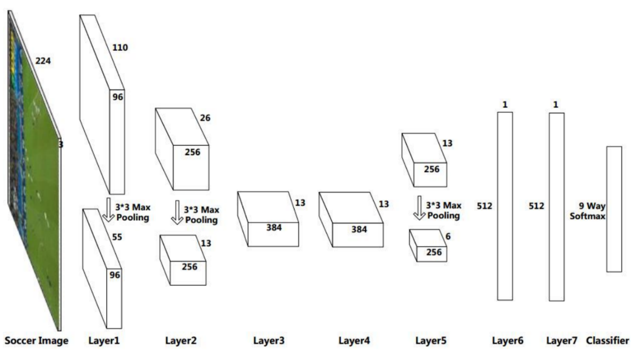
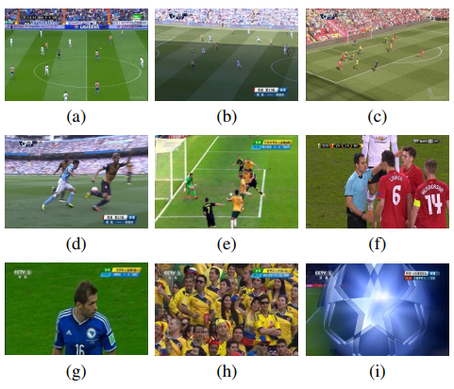
Network Types
Spatio-temporal analysis: Jiang et al.
2D CNN
Pre-Trained from ImageNET
Re-adjusted for Dataset
Softmax Output to RNN
(Jiang et al. , 2016)
H. Jiang, Y. Lu and J. Xue, "Automatic Soccer Video Event Detection Based on a Deep Neural Network Combined CNN and RNN," 2016 IEEE 28th International Conference on Tools with Artificial Intelligence (ICTAI)

Slide 43
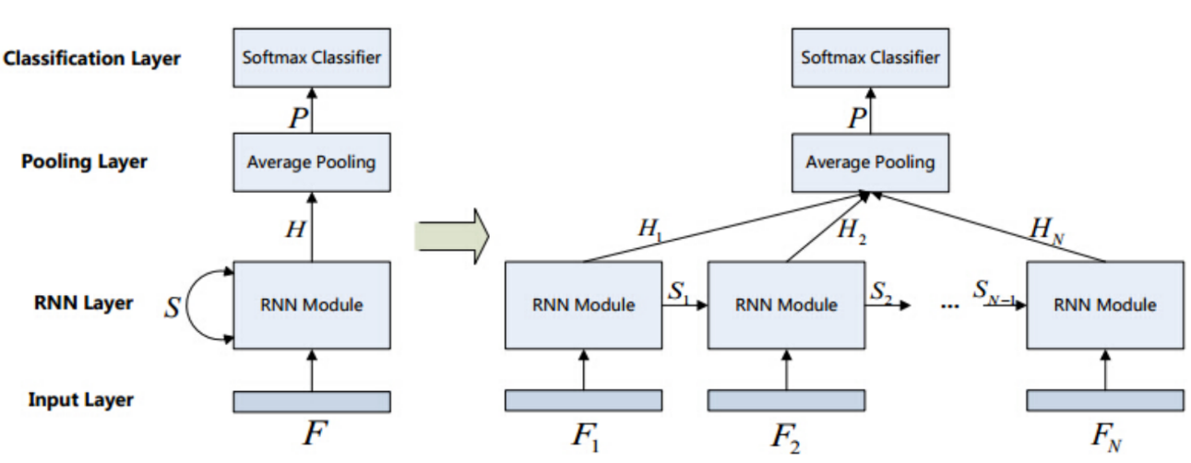
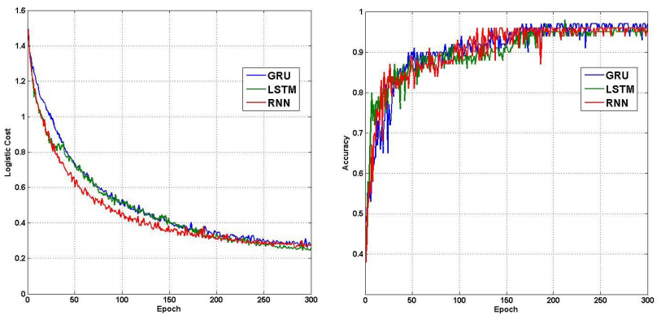
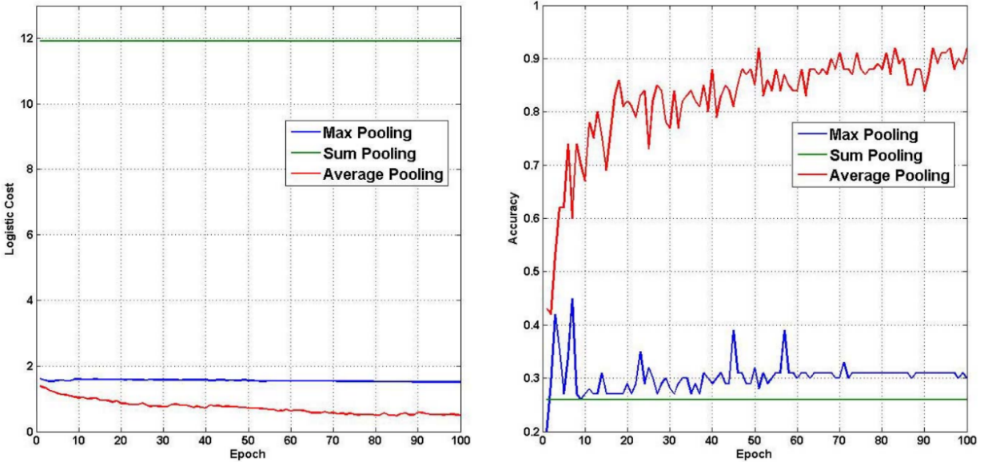
Network Types
Spatio-temporal analysis: Jiang et al.
RNN adds Temporal Element
SSID for training
(Jiang et al. , 2016)
H. Jiang, Y. Lu and J. Xue, "Automatic Soccer Video Event Detection Based on a Deep Neural Network Combined CNN and RNN," 2016 IEEE 28th International Conference on Tools with Artificial Intelligence (ICTAI).

Slide 44
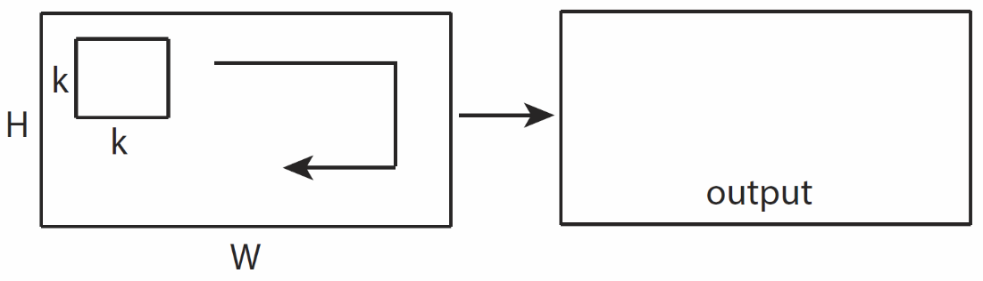
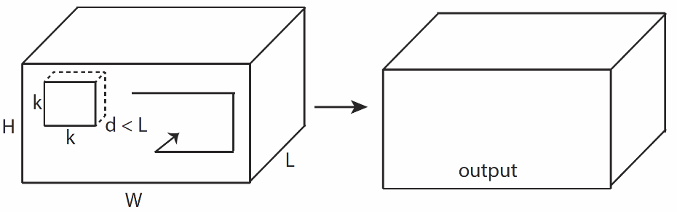
Network Types – Further Work
3D Convolutional Network Layer instead of a 2D layer:
Capture more temporal context
Spatial Variations can be high
(Tran, Du, et al. , 2015)
Tran, Du, et al. "Learning spatiotemporal features with 3d convolutional networks." Proceedings of the IEEE international conference on computer vision. 2015.

Slide 45
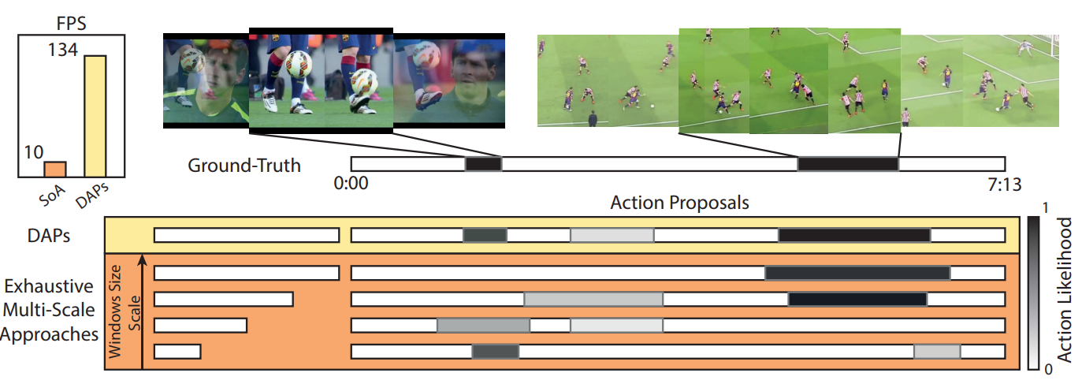
Network Types – Further Work
Enhance activity/event proposal techniques
+Boundary designation
+Classification performance
(Escoria et. al , 2016)
Escorcia, Victor, et al. "Daps: Deep action proposals for action understanding." European Conference on Computer Vision. Springer International Publishing, 2016.

Slide 46
Outline
A branch of Sports Analytics
Game Summarization vs Tactical Analysis
Dataset Nature in System Construction
Network Types
Scoring and Evaluation Metrics

Slide 47
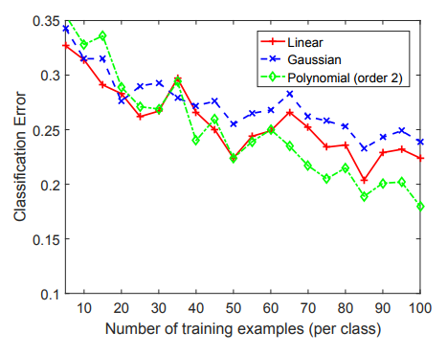
Scoring and Evaluation Metrics
Accuracy
Confusion Matrices
Recall and Precision
IoU
(Tsagkatakis et al. , 2017)
Tsagkatakis, Grigorios, Mustafa Jaber, and Panagiotis Tsakalides. "Goal!! Event detection in sports video." Electronic Imaging 2017.16 (2017): 15-20.

Slide 48
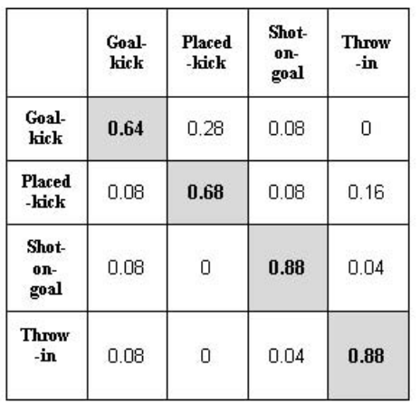
Scoring and Evaluation Metrics
Accuracy
Confusion Matrices
Recall and Precision
IoU
D’Orazio, Tiziana, and Marco Leo. "A review of vision-based systems for soccer video analysis." Pattern recognition 43.8 (2010).

Slide 49


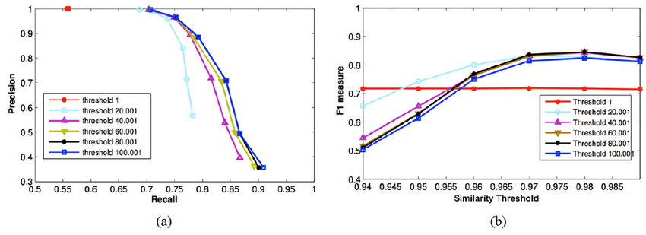
Scoring and Evaluation Metrics
Accuracy
Confusion Matrices
Recall and Precision
IoU

Slide 50

Scoring and Evaluation Metrics
Accuracy
Confusion Matrices
Recall and Precision
IoU
Ground Truth
Detection

Slide 51
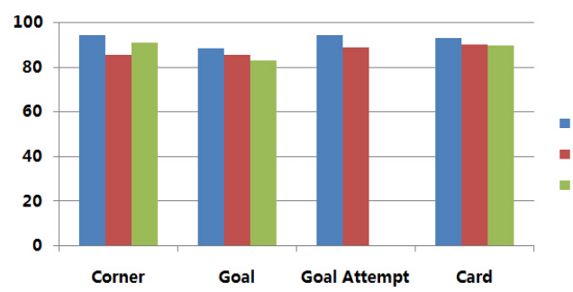
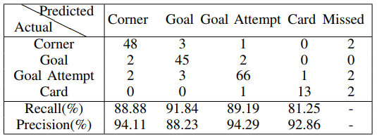
Scoring and Evaluation Metrics
Comparison with the State-of-the-art
(Jiang et al , 2016)
(Huang et al , 2006)
(Tavassolipour et al , 2014)
(Jiang et al. , 2016)
H. Jiang, Y. Lu and J. Xue, "Automatic Soccer Video Event Detection Based on a Deep Neural Network Combined CNN and RNN," 2016 IEEE 28th International Conference on Tools with Artificial Intelligence (ICTAI).

Slide 52
References
H. Jiang, Y. Lu and J. Xue, "Automatic Soccer Video Event Detection Based on a Deep Neural Network Combined CNN and RNN," 2016 IEEE 28th International Conference on Tools with Artificial Intelligence (ICTAI).
Baccouche M., Mamalet F., Wolf C., Garcia C., Baskurt A. (2010) Action Classification in Soccer Videos with Long Short-Term Memory Recurrent Neural Networks.
Ekin, Ahmet, A. Murat Tekalp, and Rajiv Mehrotra. "Automatic soccer video analysis and summarization." IEEE Transactions on Image processing 12.7 (2003): 796-807.
Tsagkatakis, Grigorios, Mustafa Jaber, and Panagiotis Tsakalides. "Goal!! Event detection in sports video." Electronic Imaging 2017.16 (2017): 15-20.
D’Orazio, Tiziana, and Marco Leo. "A review of vision-based systems for soccer video analysis." Pattern recognition 43.8 (2010).
Wang, Zengkai, Junqing Yu, and Yunfeng He. "Soccer Video Event Annotation by Synchronization of Attack–Defense Clips and Match Reports With Coarse-Grained Time Information." IEEE Transactions on Circuits and Systems for Video Technology 27.5 (2017).
Ren, Reede, and Joemon M. Jose. "Football video segmentation based on video production strategy." European Conference on Information Retrieval. Springer, Berlin, Heidelberg (2005).
C.-L. Huang, H.-C. Shih, and C.-Y. Chao, “Semantic analysis of soccer video using dynamic bayesian network,” Multimedia, IEEE Transactions on, vol. 8, no. 4, pp. 749–760, 2006.
M. Tavassolipour, M. Karimian, and S. Kasaei, “Event detection and summarization in soccer videos using bayesian network and copula.” IEEE Trans. Circuits Syst. Video Techn., vol. 24, no. 2, pp. 291–304, 2014.
Kuehne, Hildegard, et al. "HMDB: a large video database for human motion recognition." Computer Vision (ICCV), 2011 IEEE International Conference on. IEEE, 2011.
Escorcia, Victor, et al. "Daps: Deep action proposals for action understanding." European Conference on Computer Vision. Springer International Publishing, 2016.
Tran, Du, et al. "Learning spatiotemporal features with 3d convolutional networks." Proceedings of the IEEE international conference on computer vision. 2015.

Slide 53
THANK YOU!

